Slide 1
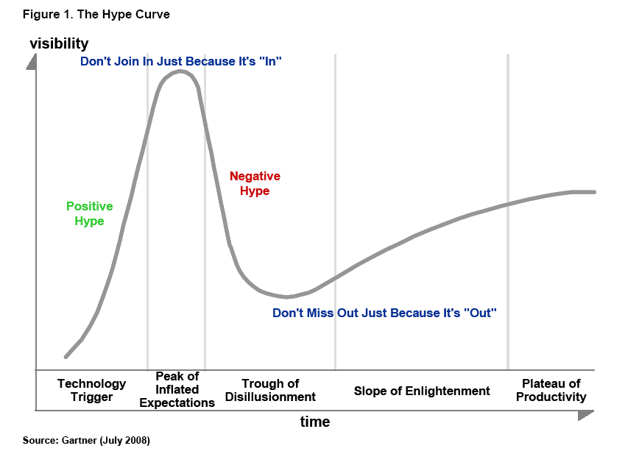
Technology Trends in Government Transformation using the Hype Curve
Dayalan Padayachy
30 July 2009
Notes:
1

Slide 2
Agenda
Definitions
The Hype Cycle
Business Drivers in Government
The Hype Cycle and Government Transformation.
Notes:
2

Slide 3
Definitions
Technology trends – changes in adopted technologies;
Government transformation – changes in public services;
Hype curve – life cycle in technology hype and usage.
  Introduced by Jackie Fenn
  “When to leap on the hype curve” – January 1995
  Method to assist in decision making.
Notes:
3

Slide 4
The Hype Curve / Cycle
Notes:
4

Slide 5
All innovations go through the hype cycle
TV
    @trigger: Solve all mankind problems
    @peak: No need for schools and teachers
    @trough: We need eye-ball to eye-ball
    @enlightenment: News, government propaganda, mass communication/entertainment
    @plateau of productivity: MJ Funeral, Bombing of Baghdad, etc,
WAP
Cell phone
Internet …
Notes:
5

Slide 6
Why the hype cycle occurs
“… phenomenon of over estimating a new technology/innovation short-term benefits and under estimating it’s long term value” - a concept termed “macro-myopia”
Linked to the human nature.
References in quote – “Mastering the Hype Cycle” by Jackie Fenn
and Mark Raskino
Notes:
6

Slide 7
Is the hype cycle useful…?
Given your organization risk profile/appetite
    It will indicate when to leap
There is predictive power in the cycle
    At least you know its going to fail sometime
Should you not be creating your own organization hype cycles…?
    YES!
Notes:
7

Slide 8
Problems with the Hype Cycle
When you jump in at the
wrong time
for
YOUR ORGANISATION!
Notes:
8

Slide 9
ICT Adoption Summary across Government
BMI-TechKnowledge
Notes:
9

Slide 10
Business drivers and priorities
  Drivers
  Service delivery at municipal level – utilities, infrastructure, roads, etc.
  Quality improvements
  Encourage citizen participation
  Expansion, service delivery
  2010 World Cup
Priorities
BMI-TechKnowledge
Notes:
10

Slide 11
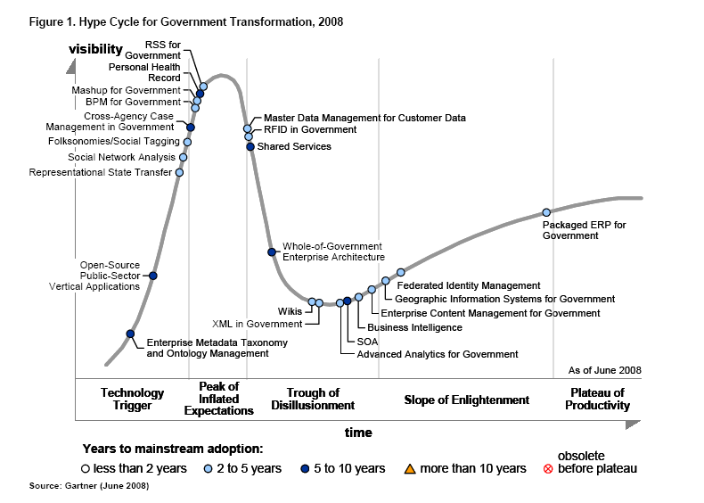
Hype Curve for Government
Transformation
OSS
Notes:
11

Slide 12
Open Source in Government
In 2007, Cabinet approved the Free Open Source Software (FOSS) Policy
The OSS Stack is Mature
  Open Office, ECM, Desktop – Ubuntu, Suse, etc
Progress:
  ‘Invisible’ penetration – websites, NOS, etc
Issues
  Not being competitive
Challenges
  Should SITA create the capability and compete with Industry?
Notes:
12

Slide 13
Focus: trough of disillusionment
MDM
Notes:
13

Slide 14
Master Data Management for Government
IFMS Project
  Purpose
  The IFMS project has been tasked by National
  Treasury to develop a government-wide Master
  Data Management (MDM) solution.
  Status
  The system is developed in several phases. The Concept of
  Operations has been completed and is undergoing peer-review.
  Subsequent phases will be to expand the hub to include other
  Master Data.
Several other projects by Government departments.
Notes:
14

Slide 15
RFID
Notes:
15

Slide 16
RFID in Government
Radio frequency identification (RFID) is an
automated data collection technology that uses
radio frequency waves to transfer data between a
reader and a tag to identify, track and locate an
item.
Position and Adoption Speed
No integral focus in government at the moment
Typical usage can be expected at
  Department of Home Affairs – Passport
  Department of Transport – Tolls
  Department of Trade and Industry – Goods
  Department of Agriculture – Lifestock
  Department of Health – Patients
  Department of Correctional Services - Prisoners, tracking, house arrest, etc.
Notes:
16

Slide 17
Shared Service
Notes:
17

Slide 18
Shared Services
A shared service is often defined as the consolidation of administrative support functions, like Human Resources (HR), Finance, IT and Procurement from several agencies into a single, stand-alone entity as efficiently and effectively as possible.
Examples of current and future
  SITA IFMS
  SITA Infrastructure (Hosting & GCCN)
  Gauteng’s Shared Services.
Notes:
18

Slide 19
GWEA
Notes:
19

Slide 20
Government Wide Enterprise Architecture
Enterprise Architecture is the methodology to align Business and IT of an enterprise. It enables an explicit architecture to be designed.
SITA has developed Framework 1.2
  Approved in the recent GITOC EMC
  Signed by Minister
Based it on the TOGAF
  The Open Group Architecture Framework.
Notes:
20

Slide 21
Wiki
XML
Notes:
21

Slide 22
Wikis
Social connectiveness – Web 2.0, citizen collaboration
SMS ID Track and Trace - Mobizen will take this further to
allow 2c access
President Zuma has made it clear he wants to have a line of
sight on citizens complaints
XML in Government
Open Document Format (ODF) is a government approved standard for XML data.
It has been incorporated in the MIOS (Minimum Inter-Operability Standards).
At least 17 document writers subscribe to it including Microsoft Office 2003 Service Packs and Microsoft Office 2007.
Notes:
22

Slide 23
SOA
BI
ECM
Notes:
23

Slide 24
SOA in Government
A style of application architecture -
A method of exposing services so that they can be repackaged (involving staff organization, IT tools, Skills and not only technology)
DHA example
Efforts in this area:
SITA Innovation Unit working on a Universal Services Bus
(USB) for Government departments (Pilot with Faritec).
Notes:
24

Slide 25
Business Intelligence
An interactive process for exploring and analyzing domain specific information. Gives business trends and patterns
Many implementations for different purposes
  SAPS (crime)
  Departments (to understand their own business)
  ‘War rooms” (to coordinate service delivery).
Notes:
25

Slide 26
Enterprise Content Management
A range of technologies that drive business process productivity through effective use and collaboration around content.
Many implementations for different purposes – document
management software.
OSS efforts in the area include
Alfresco
Plone
Knowledge Tree, etc.
Notes:
26

Slide 27
How do we compare on the
Hype Cycle?
Not bad
Its not about technology, its about solving people problems
It is about service delivery
It poses a multitude of opportunities for the ICT industry to partner with government
Challenges
  Cost of IT, broadband, etc.
Notes:
27

Slide 28
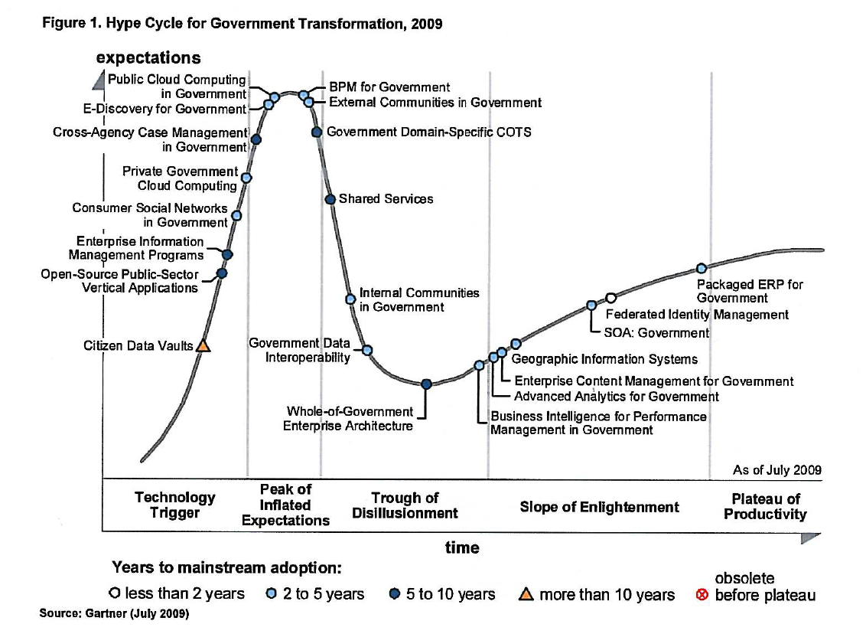
2009 Hype Cycle
New Technologies
Changes

Slide 29
Thank you!
“To you the Earth yields her fruit
and you shall not want if you
know how to fill your hands”
Khalil Gibran
Notes:
29

